Slide 1
LinkedOut
Quan Nguyen
David Liu
Khussal Pradhan
Aurora Jitrskul

Slide 2
The Application – Who & What
Client/End-users
Texas A&M Students Current students seeking internships and full-time positions through peer referrals
Texas A&M Alumni Graduates working at companies who want to help fellow Aggies land jobs
Career Seekers Anyone in the TAMU network looking to leverage connections for job opportunities

Slide 3
The Application – Who & What
What problems does it solve?
Helps TAMU students and alumni connect for job referrals within a trusted network
Enables verification of company employment to ensure legitimate referral opportunities
Simplifies the referral request process with custom screening questions
Provides direct private communication between referrers and candidates
How does it solve those problems?
Provides full authentication with TAMU email verification to ensure network exclusivity
Allows users to verify company employment via company email domain matching
Enables referrers to create, manage, and screen referral posts with custom questions
Facilitates private conversations automatically when referral requests are approved
Provides comprehensive profile management with resume uploads and experience tracking

Slide 4




System Design – Key Component
Database
- PostgreSQL (production-ready)
Frontend
- HTML/ERB views with Bootstrap 5
- Custom TAMU theme (maroon color scheme)
- Stimulus.js for lightweight interactivity
- Turbo Rails for SPA-like navigation
Backend
- Ruby on Rails MVC framework
- BCrypt for password hashing
- Active Storage for resume uploads
- Action Mailer for email verification
External Services
- SMTP Service (Mailtrap)
For sending verification emails to users

Slide 5
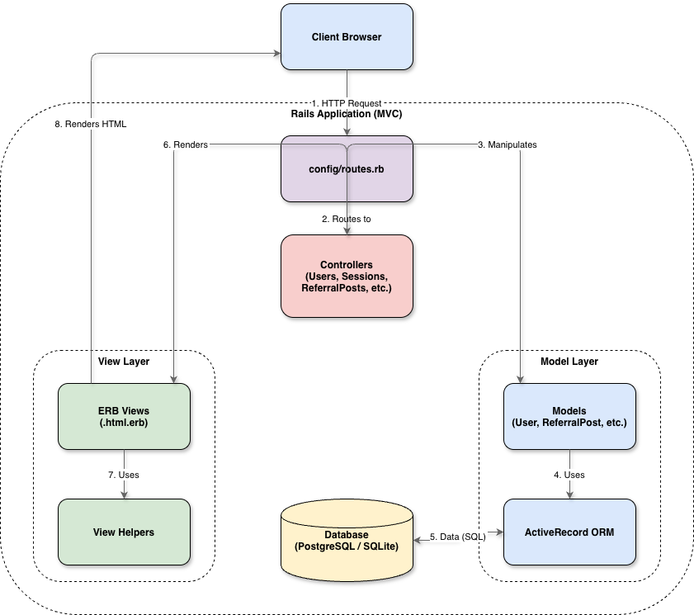
Architecture Diagram

Slide 6
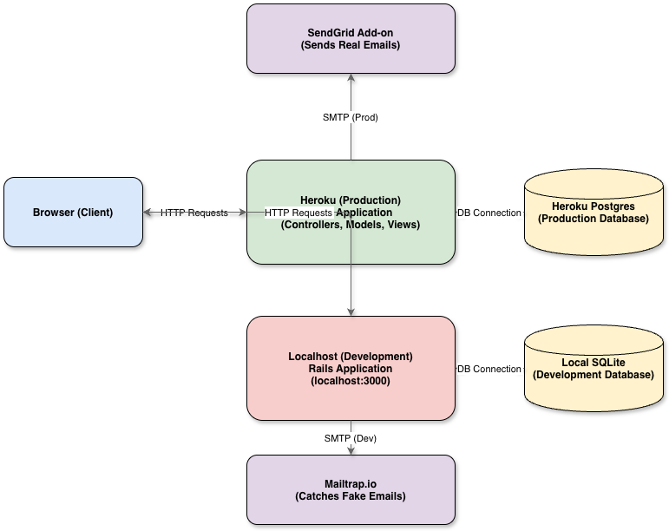
System Diagram

Slide 7
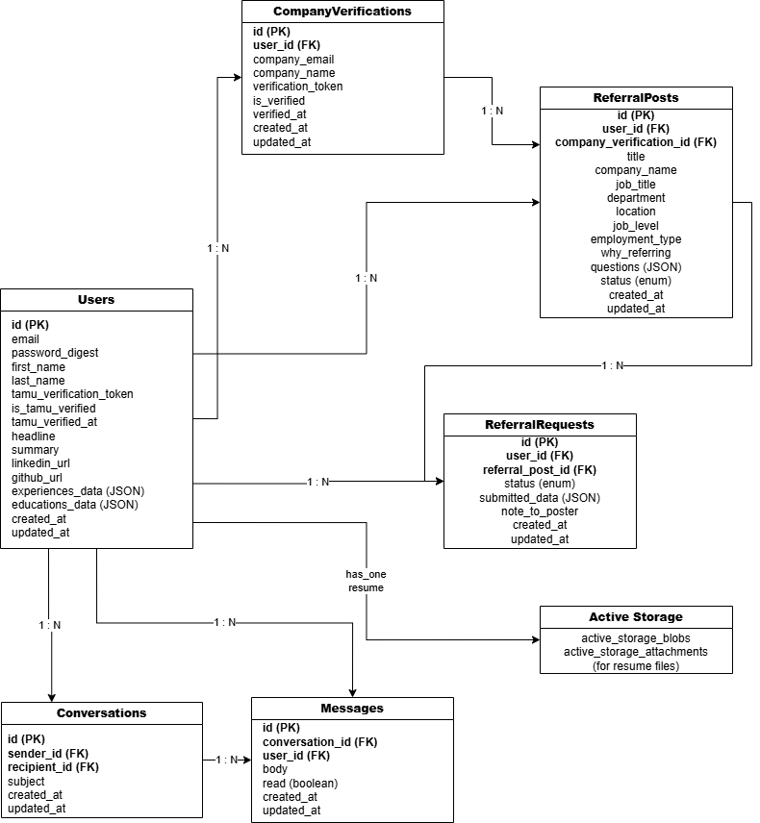
Database Diagram

Slide 8
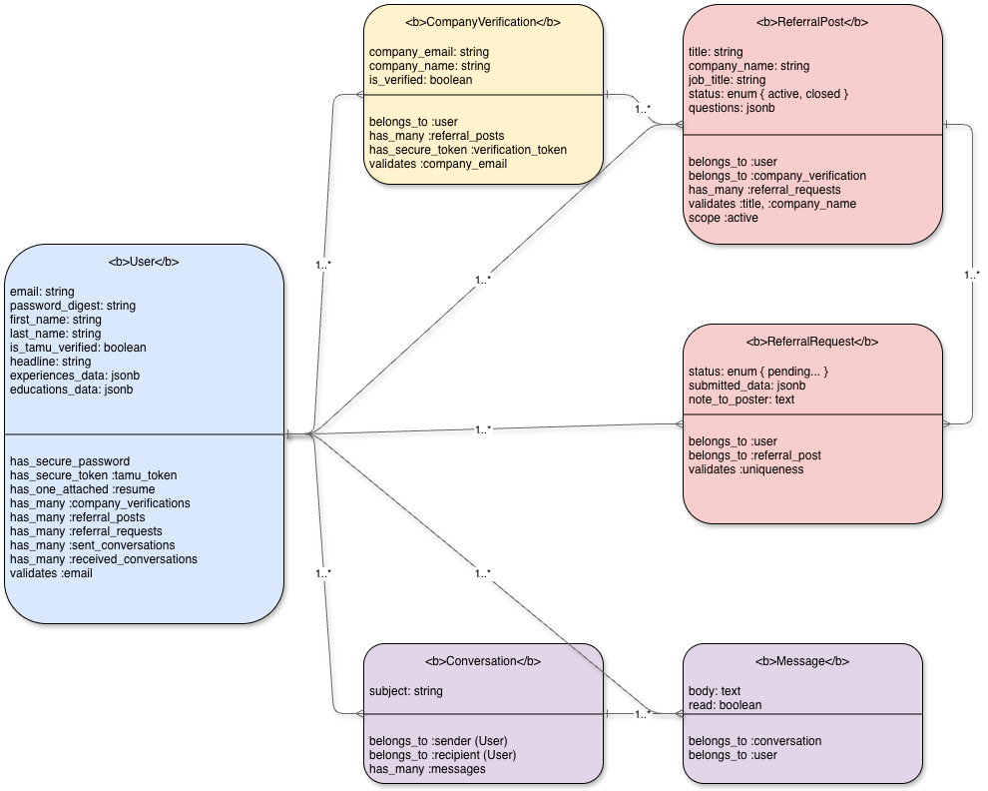
Class Diagram

Slide 9

Database Design Model (in words)
User Relationships
User one-to-many ReferralPosts (as poster)
User one-to-many ReferralRequests (as requester)
User one-to-many CompanyVerifications
User one-to-many Messages (as sender)
User one-to-many Conversations (as sender)
User one-to-many Conversations (as recipient)
ReferralPost Relationships
ReferralPost belongs-to User (poster)
ReferralPost belongs-to CompanyVerification
ReferralPost one-to-many ReferralRequests ReferralRequest Relationships
ReferralRequest belongs-to User (requester)
ReferralRequest belongs-to ReferralPost
CompanyVerification Relationships
CompanyVerification belongs-to User
CompanyVerification one-to-many ReferralPosts (with restrict_with_error)
Conversation Relationships
Conversation belongs-to User (as sender)
Conversation belongs-to User (as recipient)
Conversation one-to-many Messages
Message Relationships
Message belongs-to Conversation
Message belongs-to User

Slide 10
Framework and Tool Used
Ruby on Rails Model-View-Controller Framework
SQLite3/PostgreSQL Relational Database System
RSpec Unit and integration tests
Cucumber Acceptance/BDD tests
Capybara Browser automation for system tests
FactoryBot Test data generation
SimpleCov Code coverage reporting
Bootstrap 5 Responsive UI framework
Stimulus.js Lightweight JavaScript framework
Turbo Rails Fast page transitions
Custom TAMU Theme Brand-consistent styling
Action Mailer Email delivery system
Active Storage File upload management
Mailtrap (Dev) / SendGrid (Prod) SMTP services
Heroku Production hosting
GitHub Actions (Optional) CI/CD pipeline

Slide 11




Design Pattern Used
MVC (Model-View-Controller) Core Rails pattern for separation of concerns
Secure Token Pattern Used for email verification
Callback Pattern Used for maintaining data integrity
Authorization Filter Pattern Used for access control

Slide 12
System Design – Major Design Choices & Justification
CHOICES | JUSTIFICATIONS
TAMU Email Verification | Ensures network exclusivity and trust by limiting access to verified Texas A&M students and alumni.
Company Email Domain Matching | Validates employment claims by requiring company email addresses that match the company name.
JSONB for Experiences/Education | Flexible schema allows users to add unlimited work history and education entries without database migrations.
Enum for Status Management | Provides type-safe status tracking (pending/approved/rejected) with built-in query methods like request.pending?.
Automatic Conversation Creation | Streamlines communication by auto-creating conversations when referral requests are approved.
Active Storage for Resumes | Scalable file upload system that works with local storage (dev) and cloud storage (production).
Kaminari Pagination | Improves performance by loading referral posts in pages rather than all at once.
Bootstrap + Custom Theme | Combines rapid development with consistent TAMU branding (maroon color scheme).

Slide 13
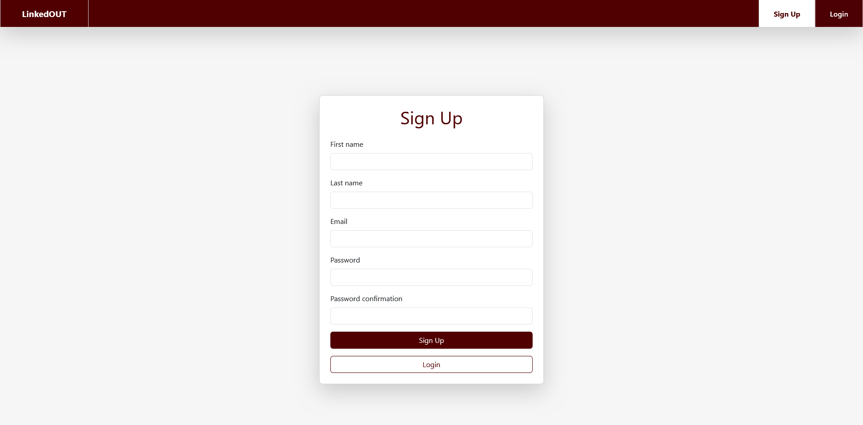
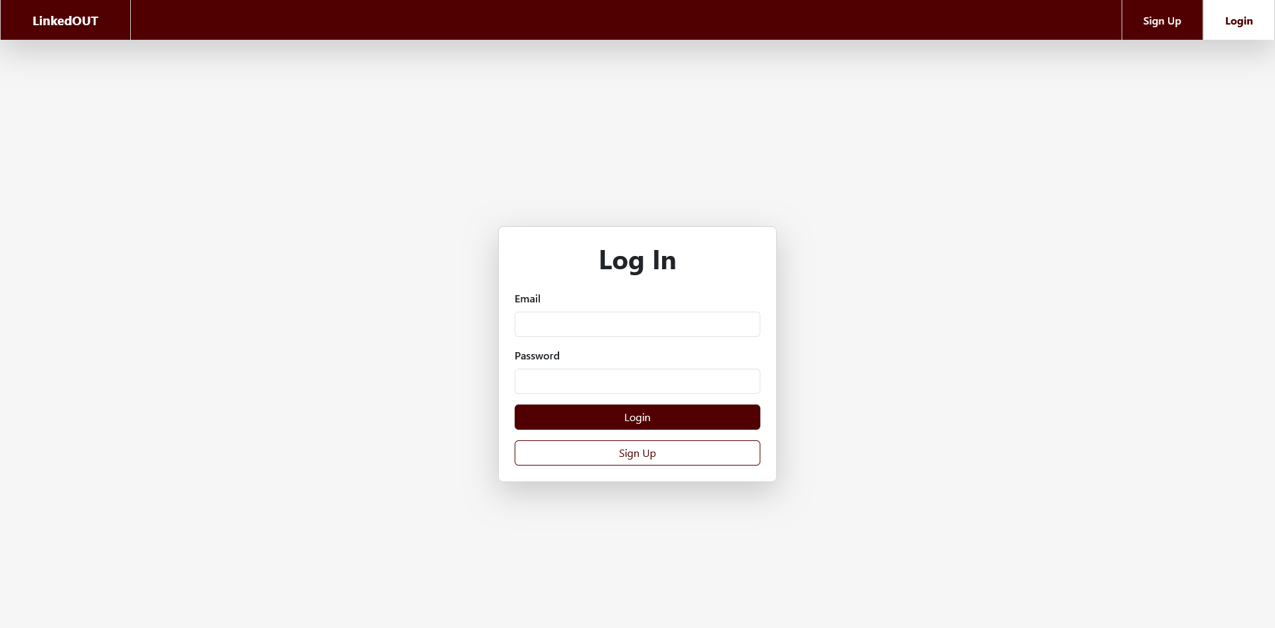

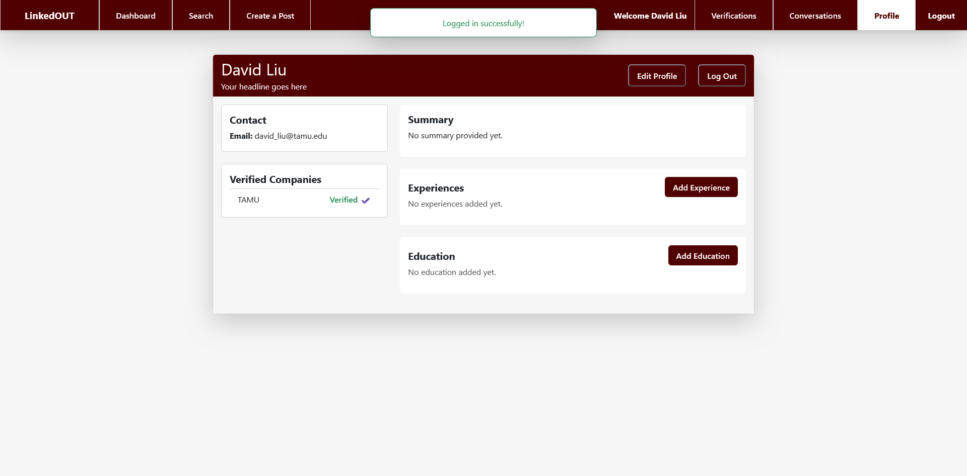
D.Liu
D.Liu
Sign Up Page
Login Page
Upon first visit of LinkedOUT, D.Liu creates an account, provide the created login, and lands on the profile page
D.Liu
Profile Page

Slide 14
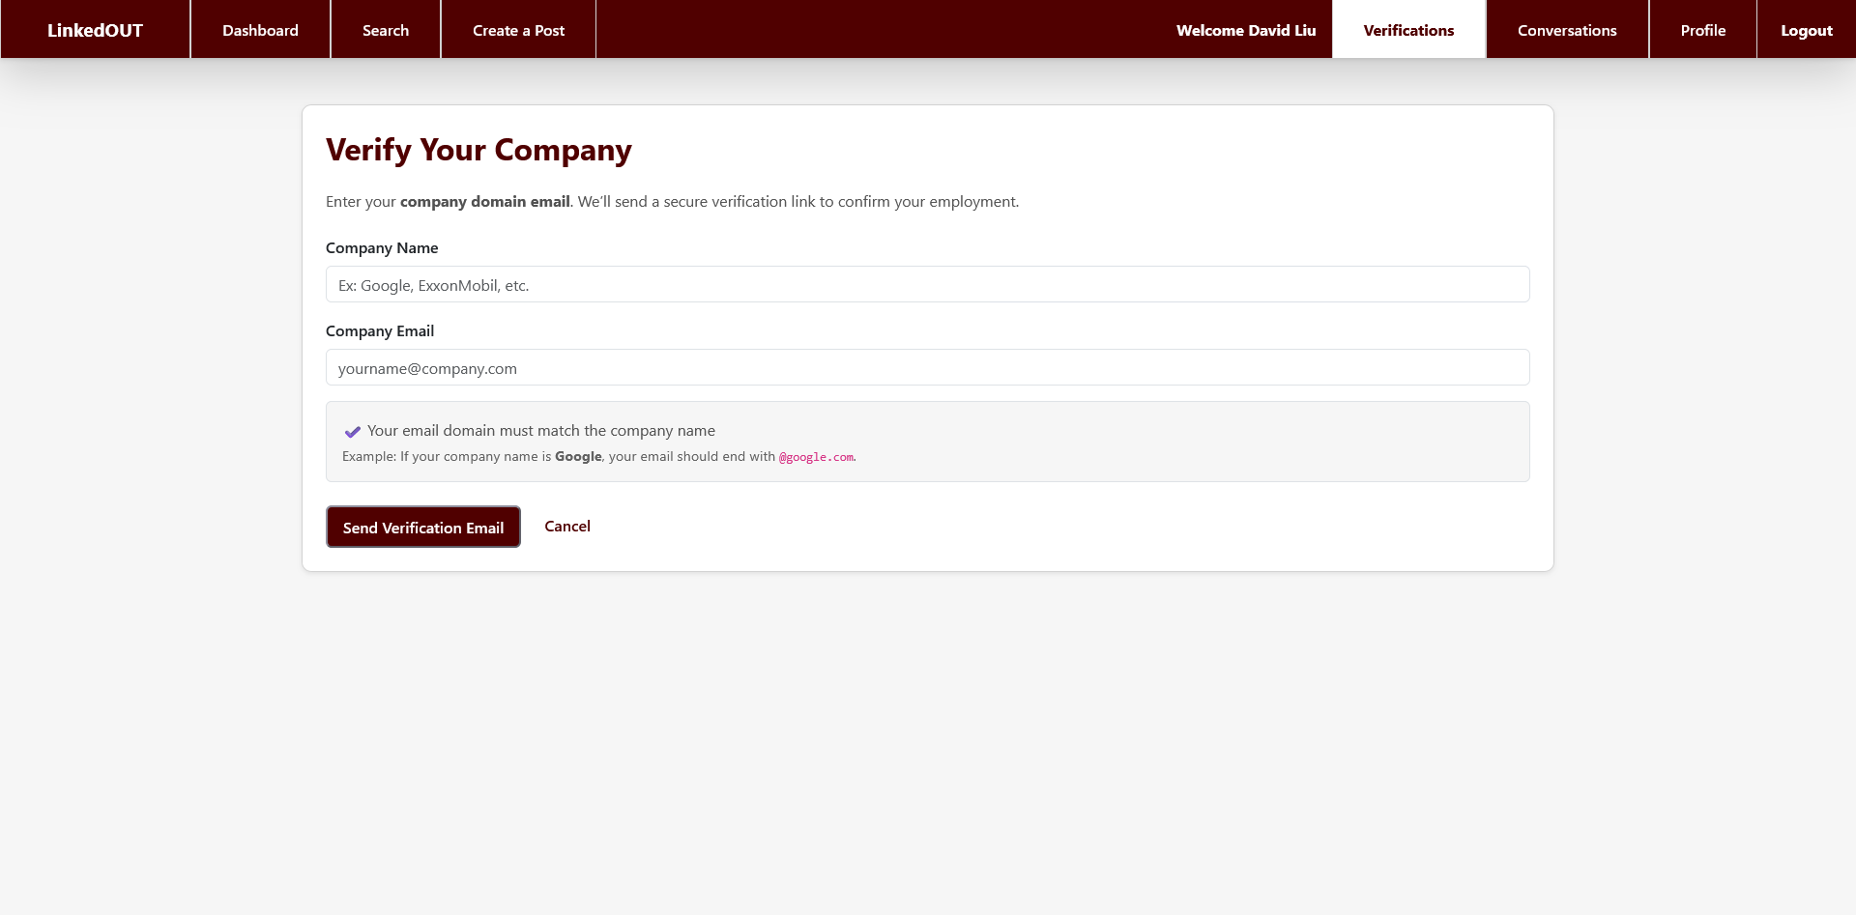
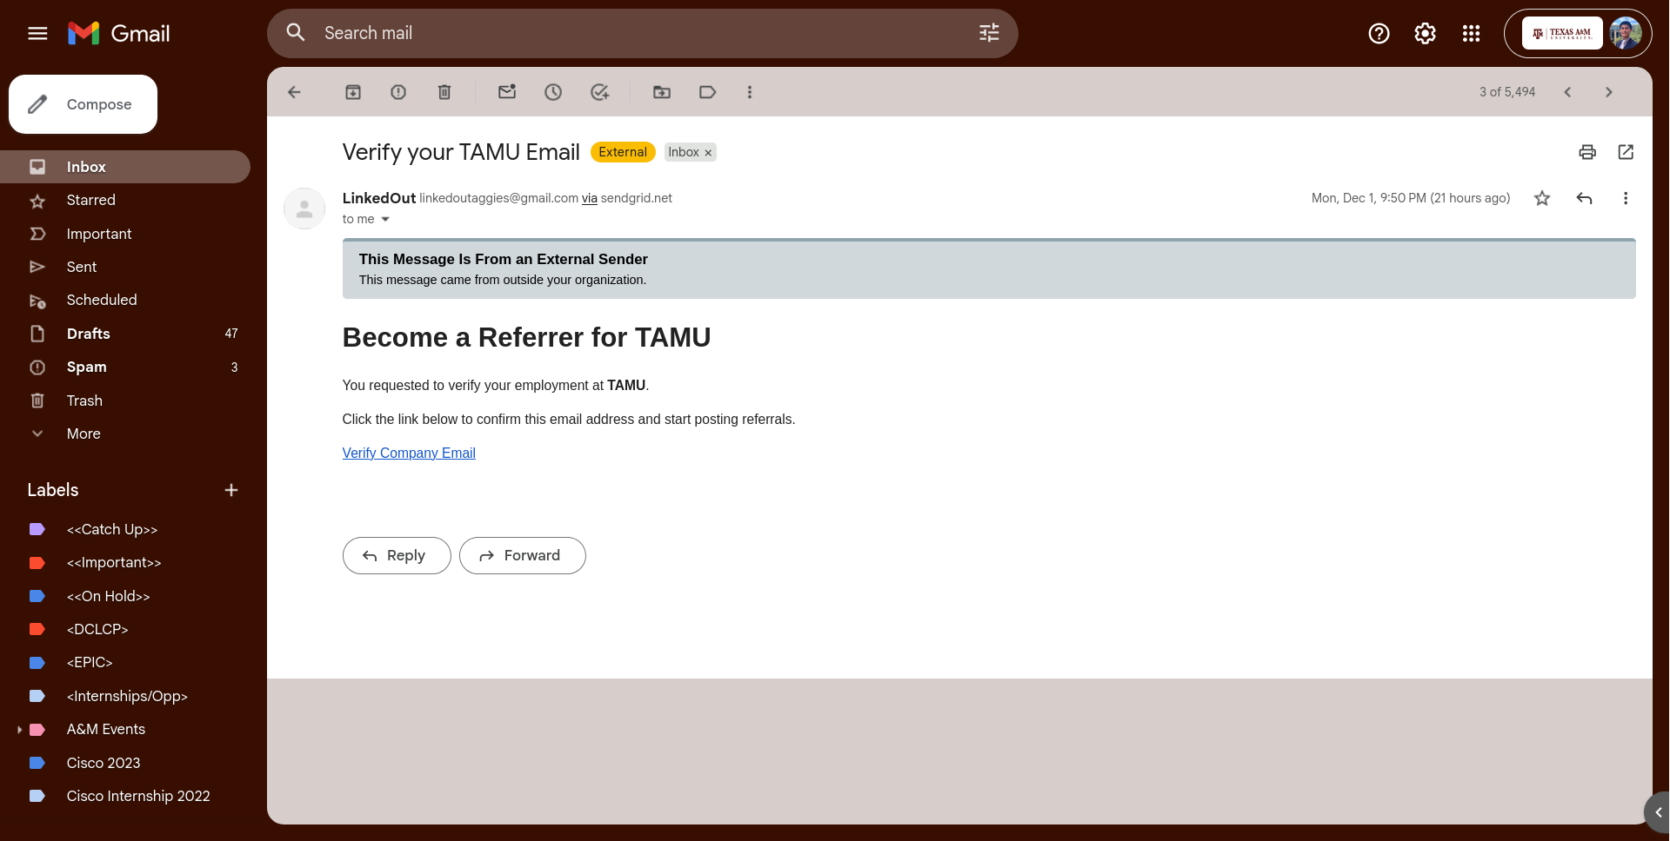
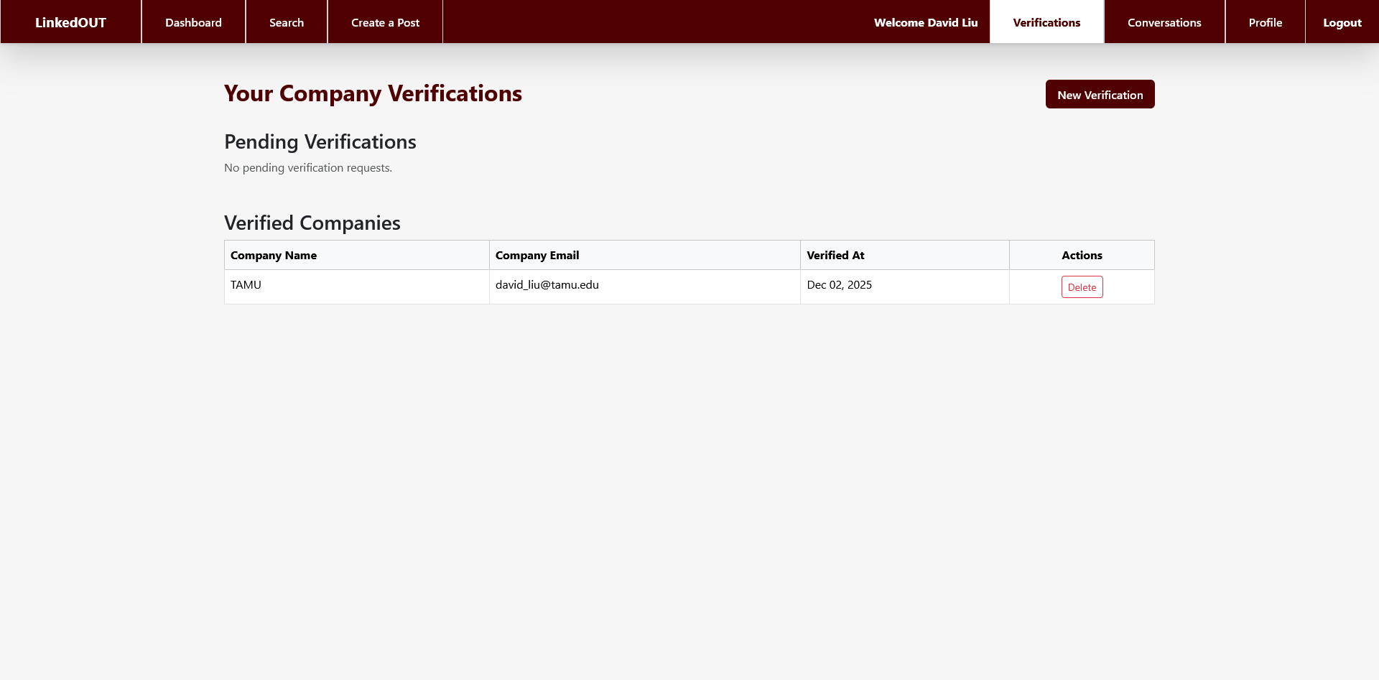
D.Liu
D.Liu
Verification Creation Page
Verification Email
D.Liu then verifies that he works for TAMU via the Verification Creation Page, then confirms the verification from his email inbox, and then views his verification from the Verification View page.
D.Liu
Verification View Page

Slide 15
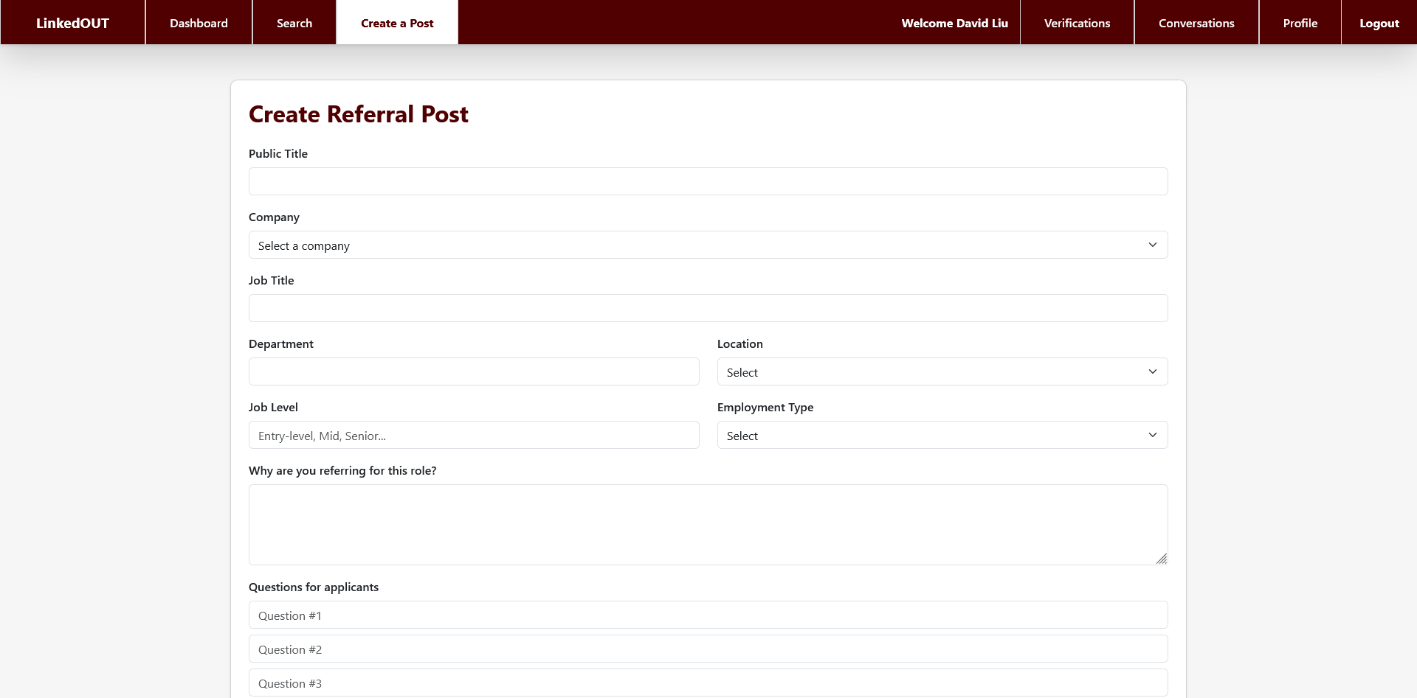
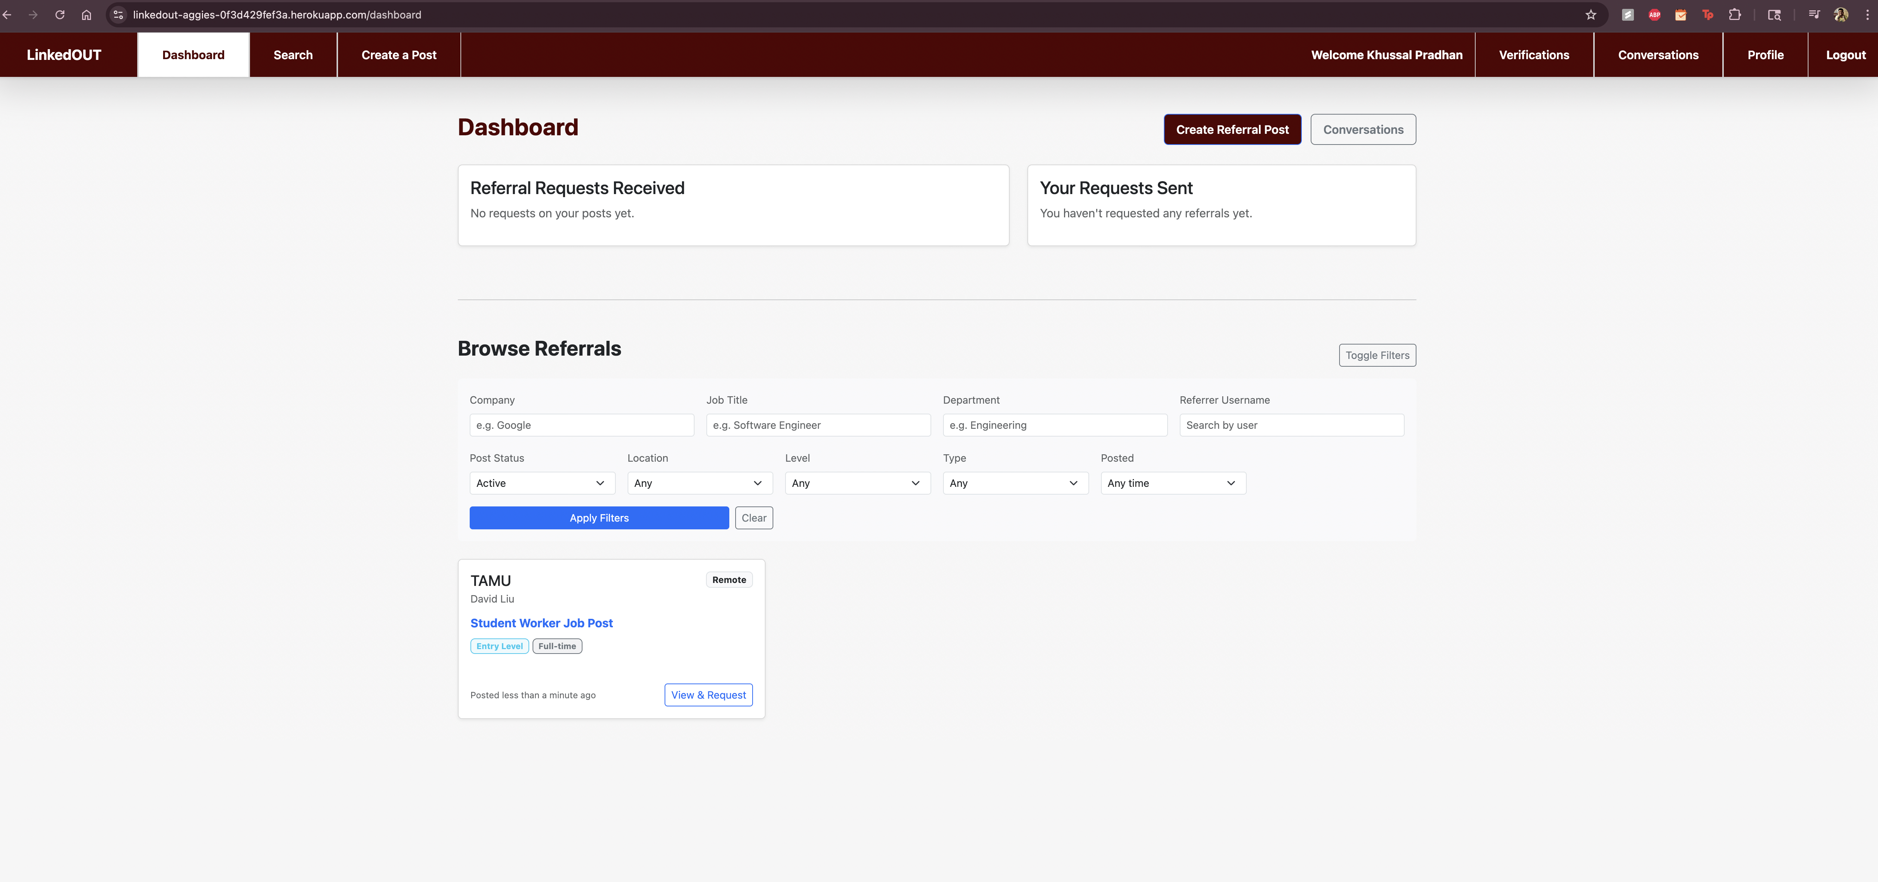
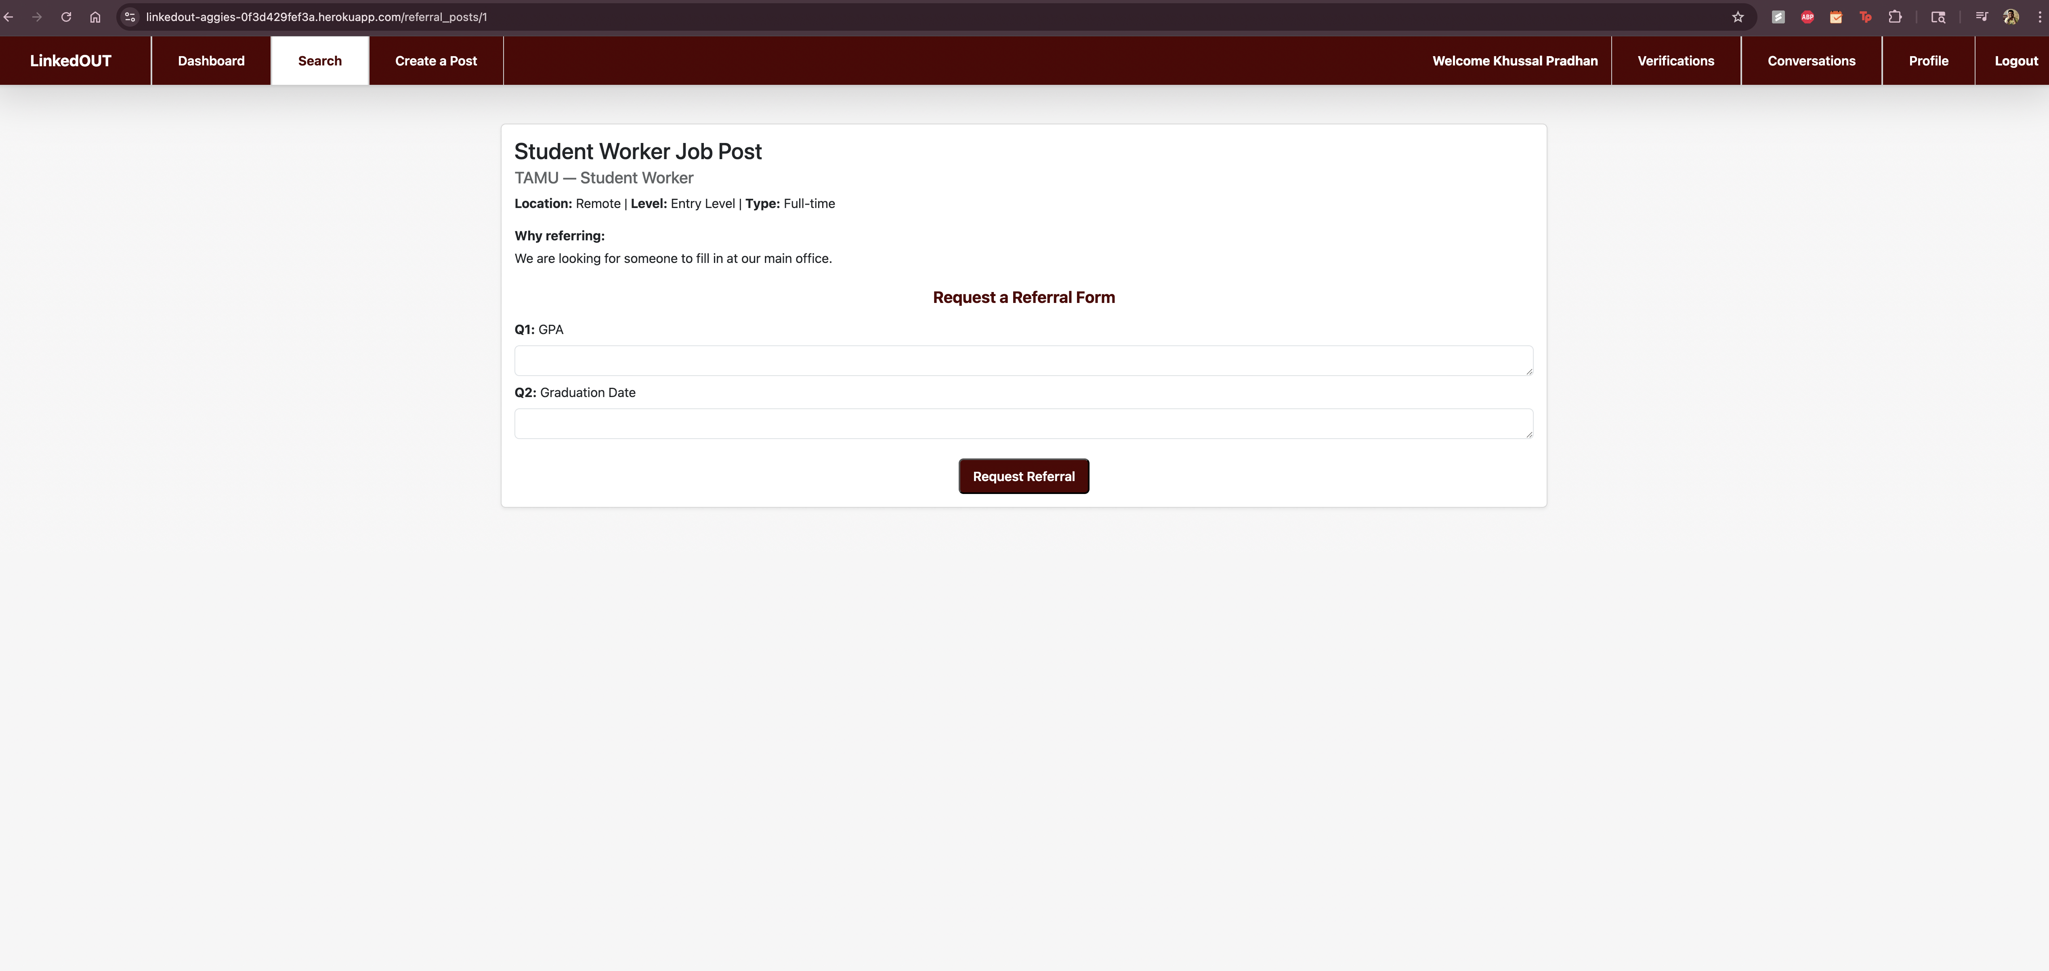
D.Liu creates a new referral post, which is later seen by K.Pradhan, who then is prompted by a referral request.
D.Liu
Creating a referral post
K. Pradhan
K. Pradhan
Dashboard page
Creating a referral request

Slide 16
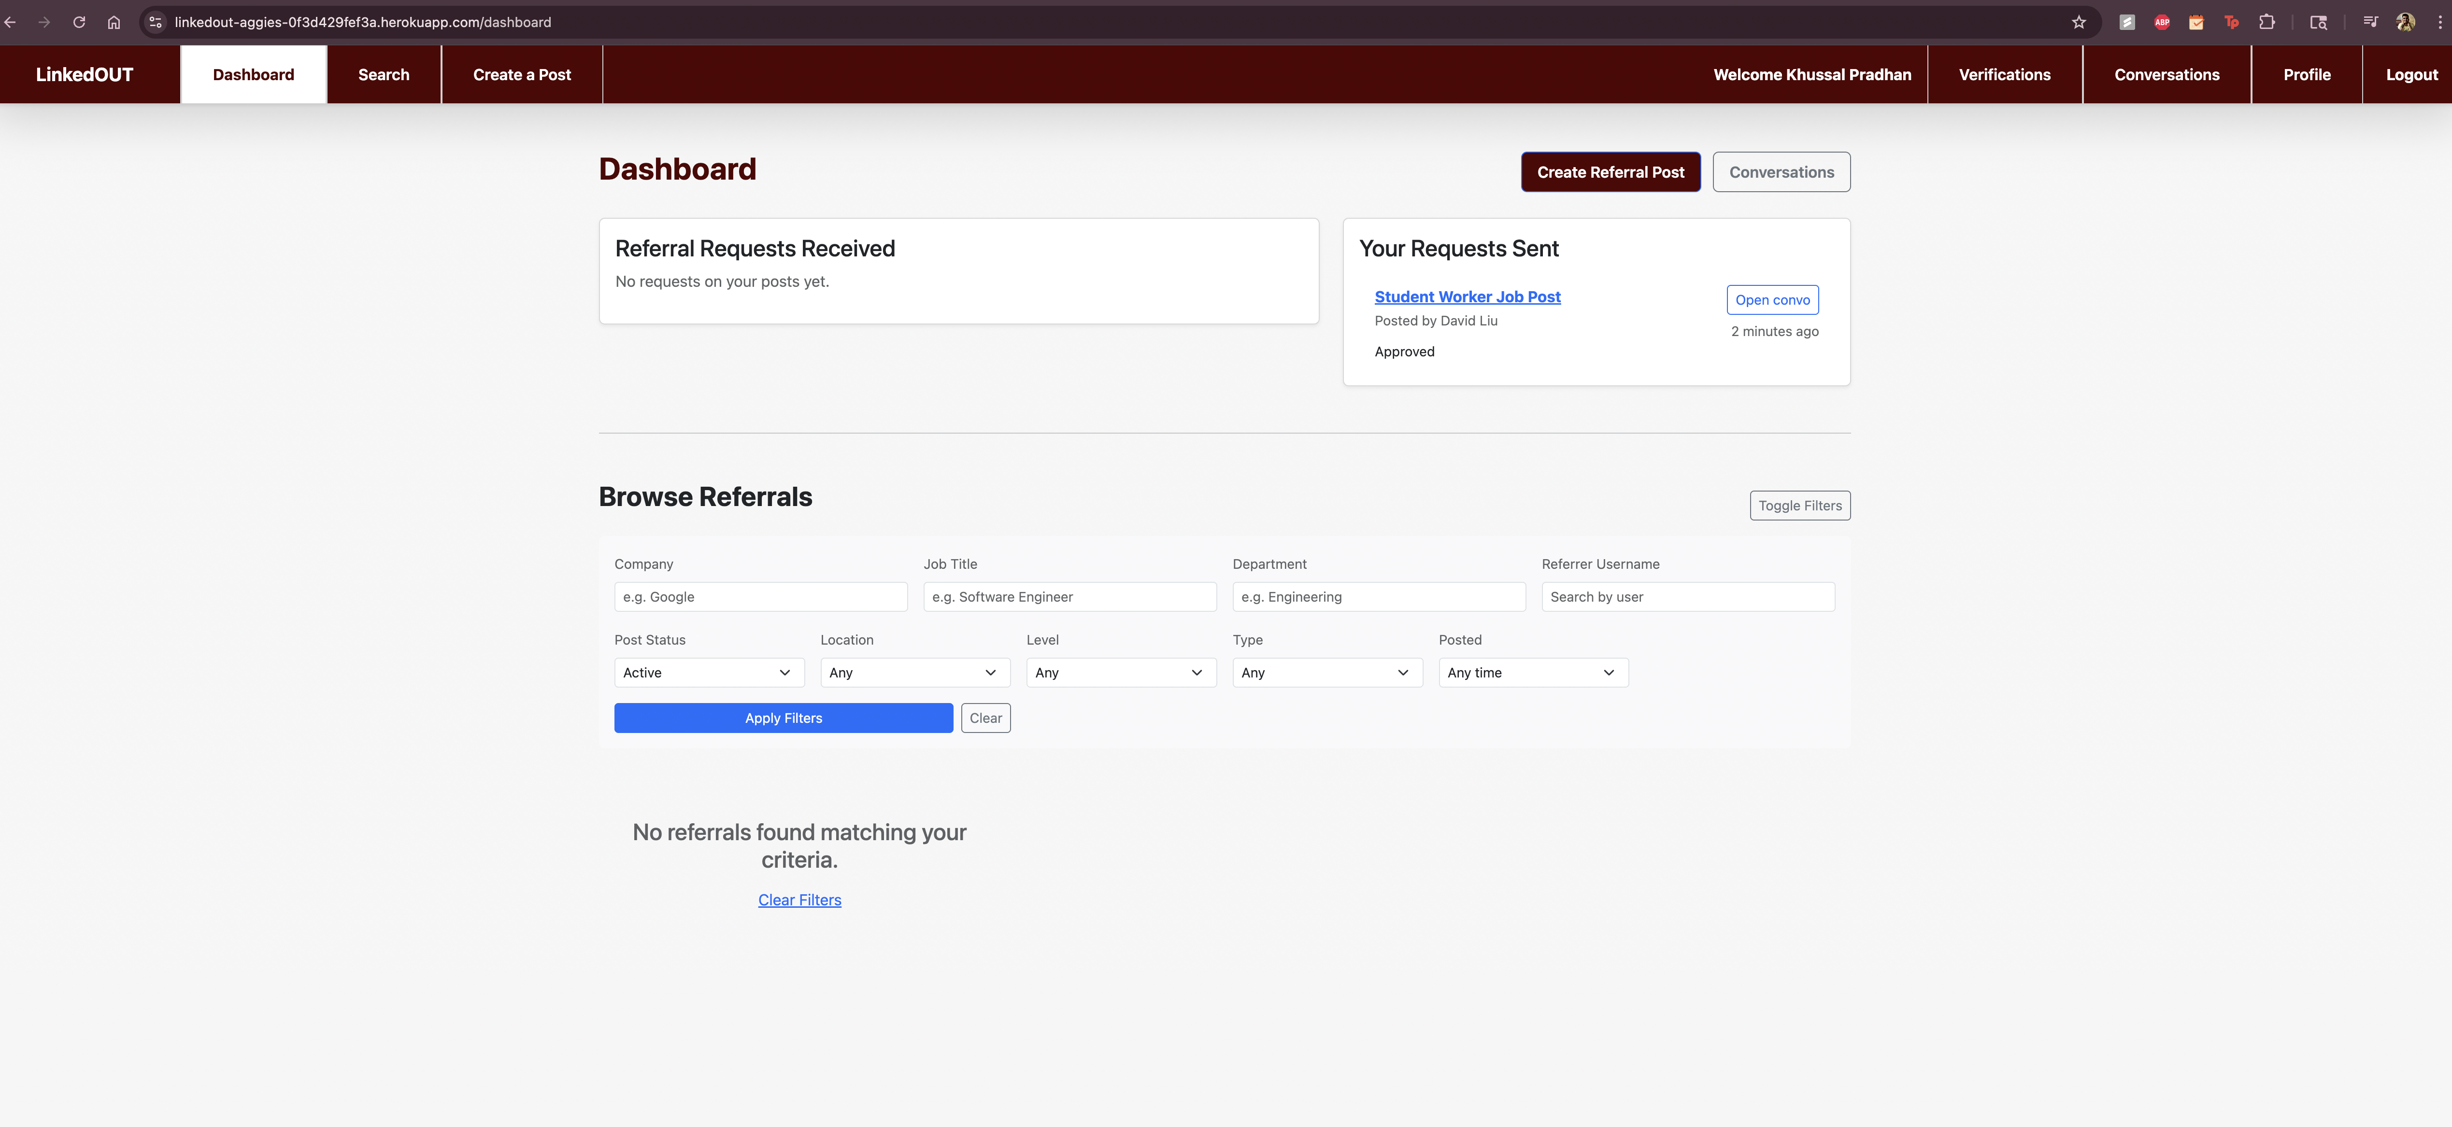
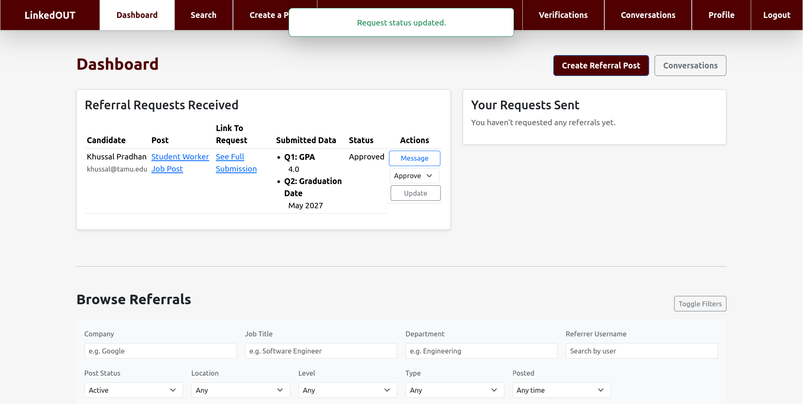
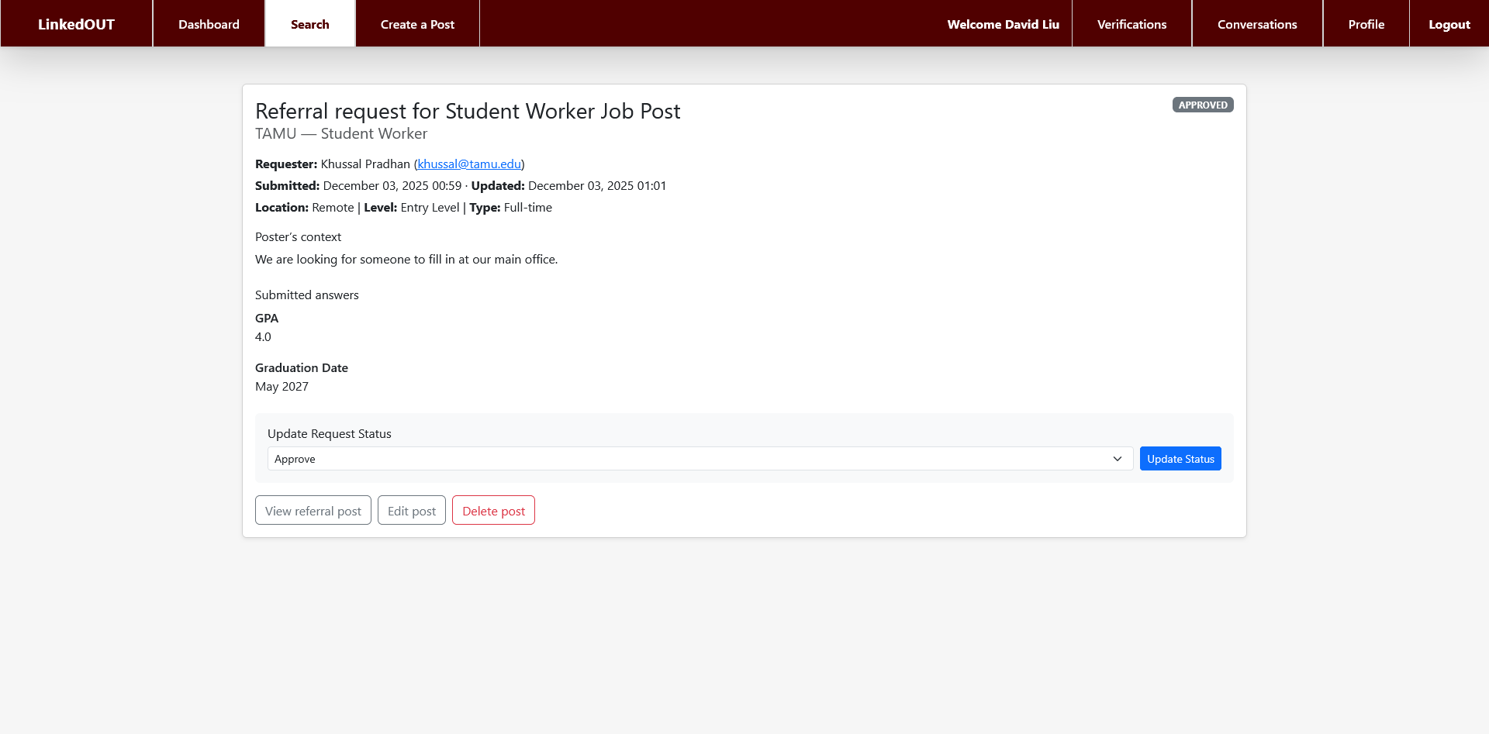
K. Pradhan
D.Liu
Created Referral Request
Approves Request on Dashboard
K.Pradhan creates a request, which is then populated on his dashboard.
D.Liu approves the request from K.Pradhan on dashboard page. Then views the full submission.
D.Liu
Referral Request Full View

Slide 17
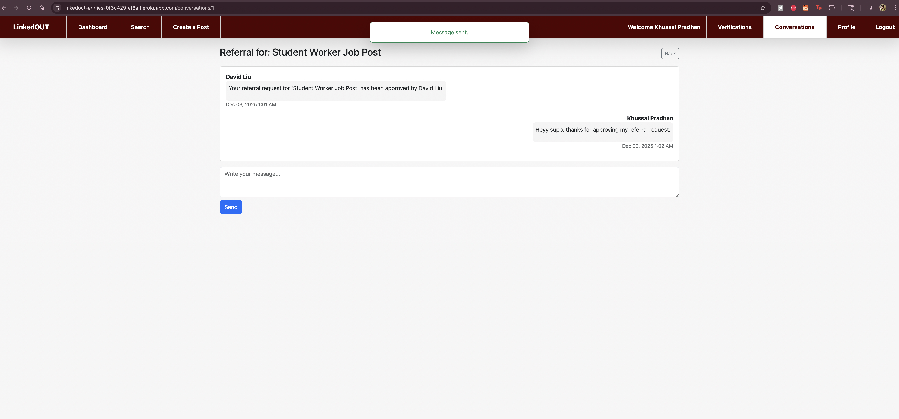
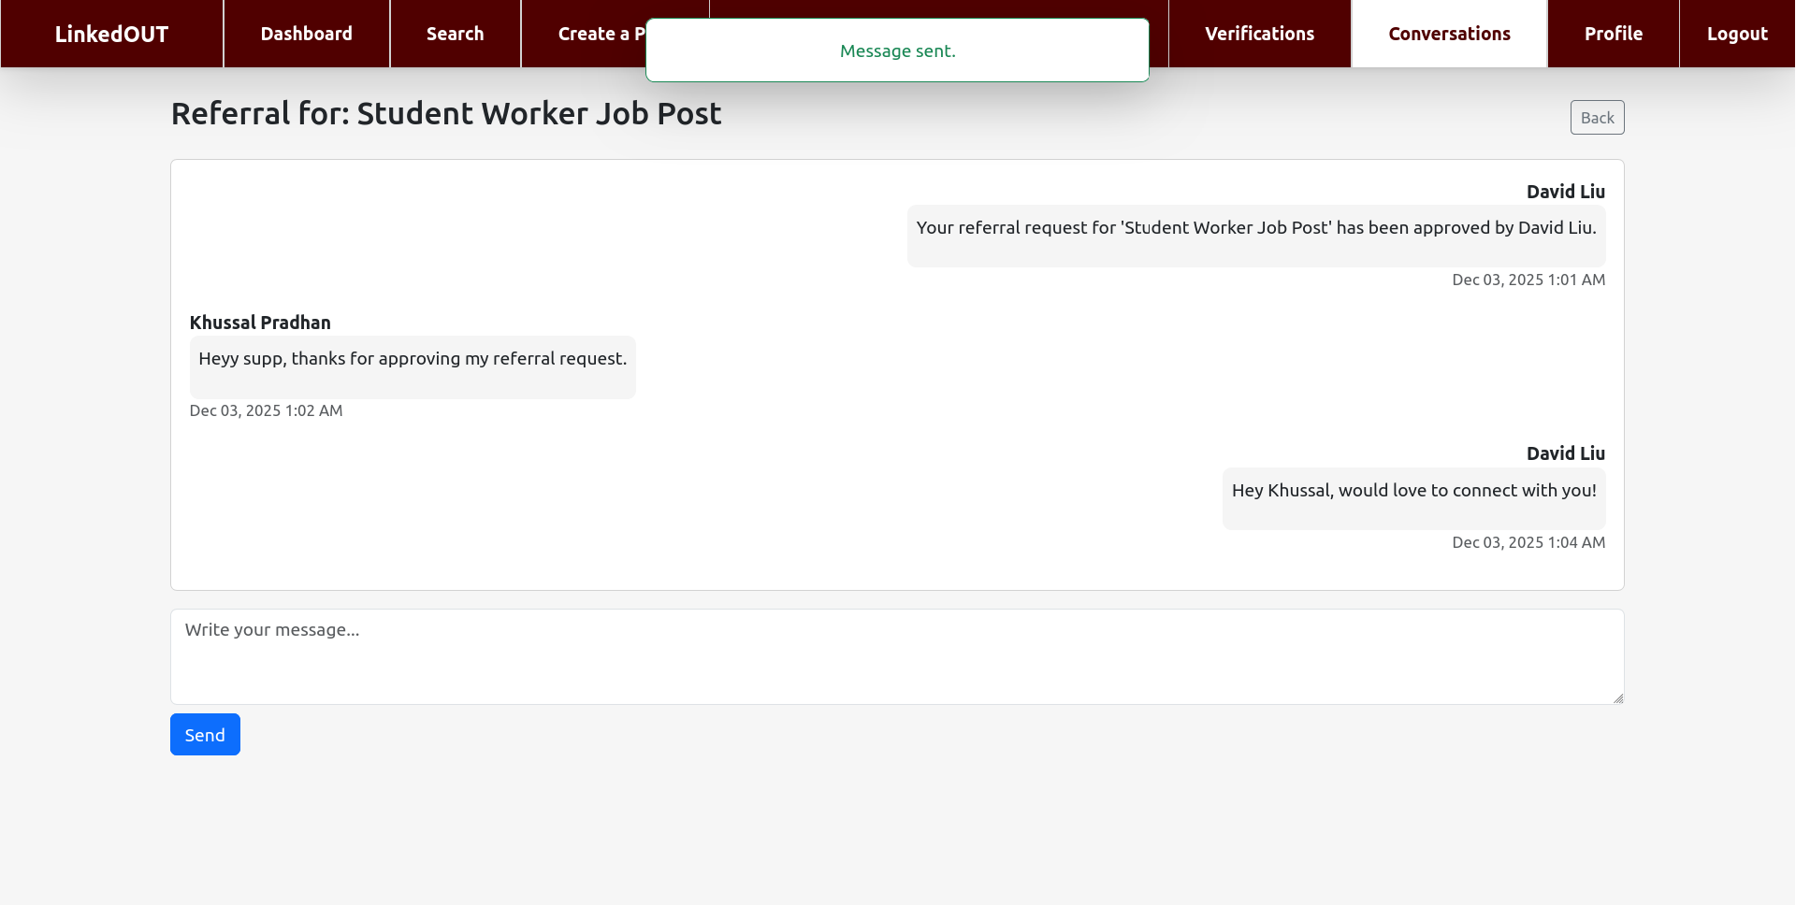
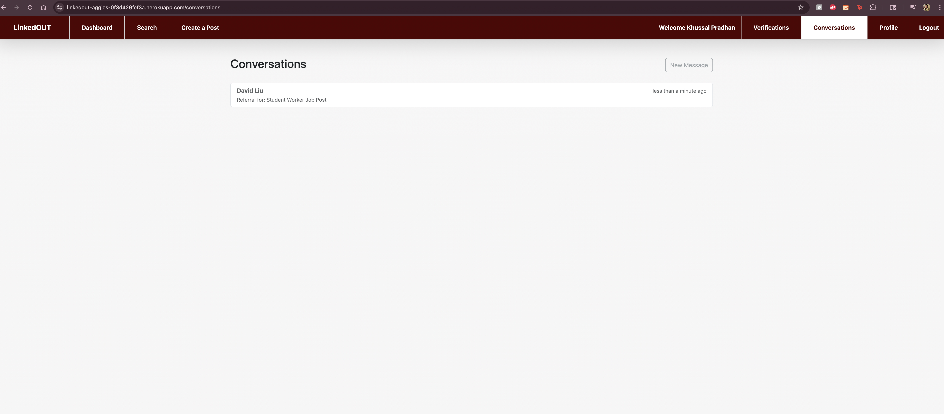
K.Pradhan then messages D.Liu about his approval.
D.Liu messages K.Pradhan back.
K.Pradhan views the conversation under the conversation view page
K. Pradhan
Messages D.Liu
D.Liu
K. Pradhan
Messages K.Pradhan back
Conversation view page

Slide 18
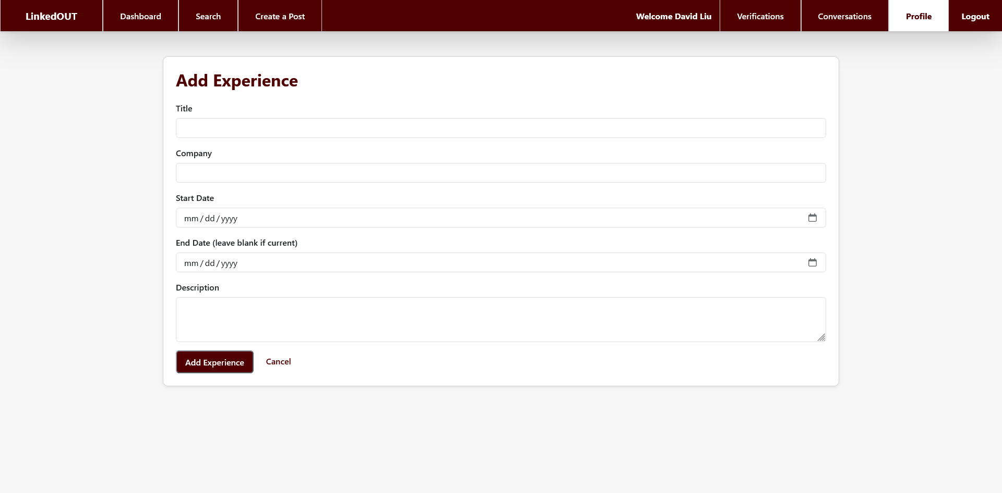
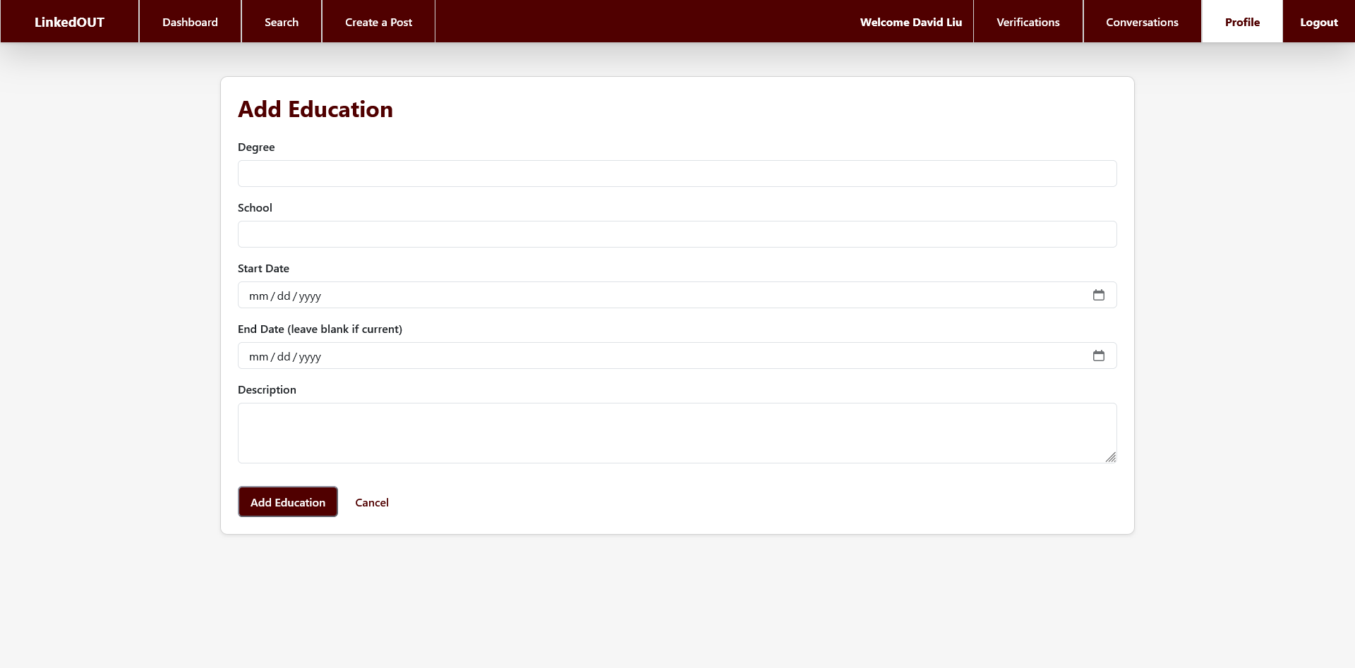
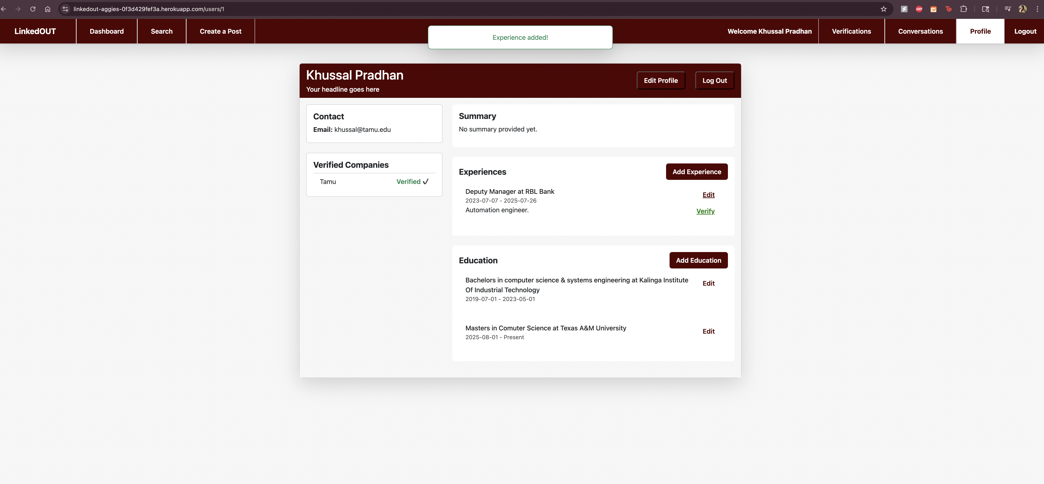
K. Pradhan
K.Pradhan
Add Experience Page
Add Education Page
After messaging back and forth with D.Liu, K.Pradhan decides to add his experience and education on his profile page.
K.Pradhan
Profile Page

Slide 19
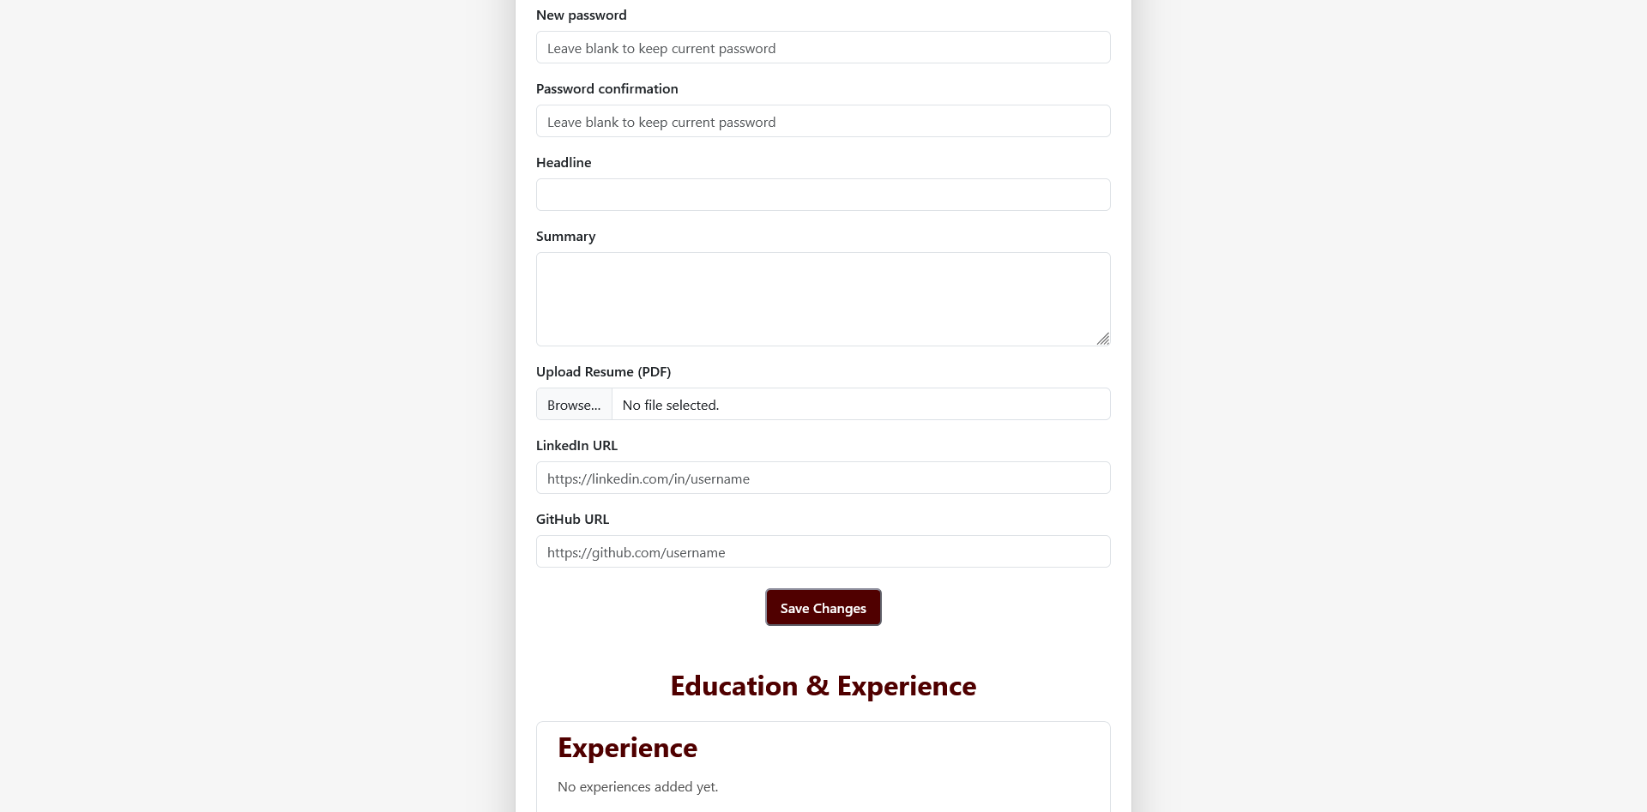
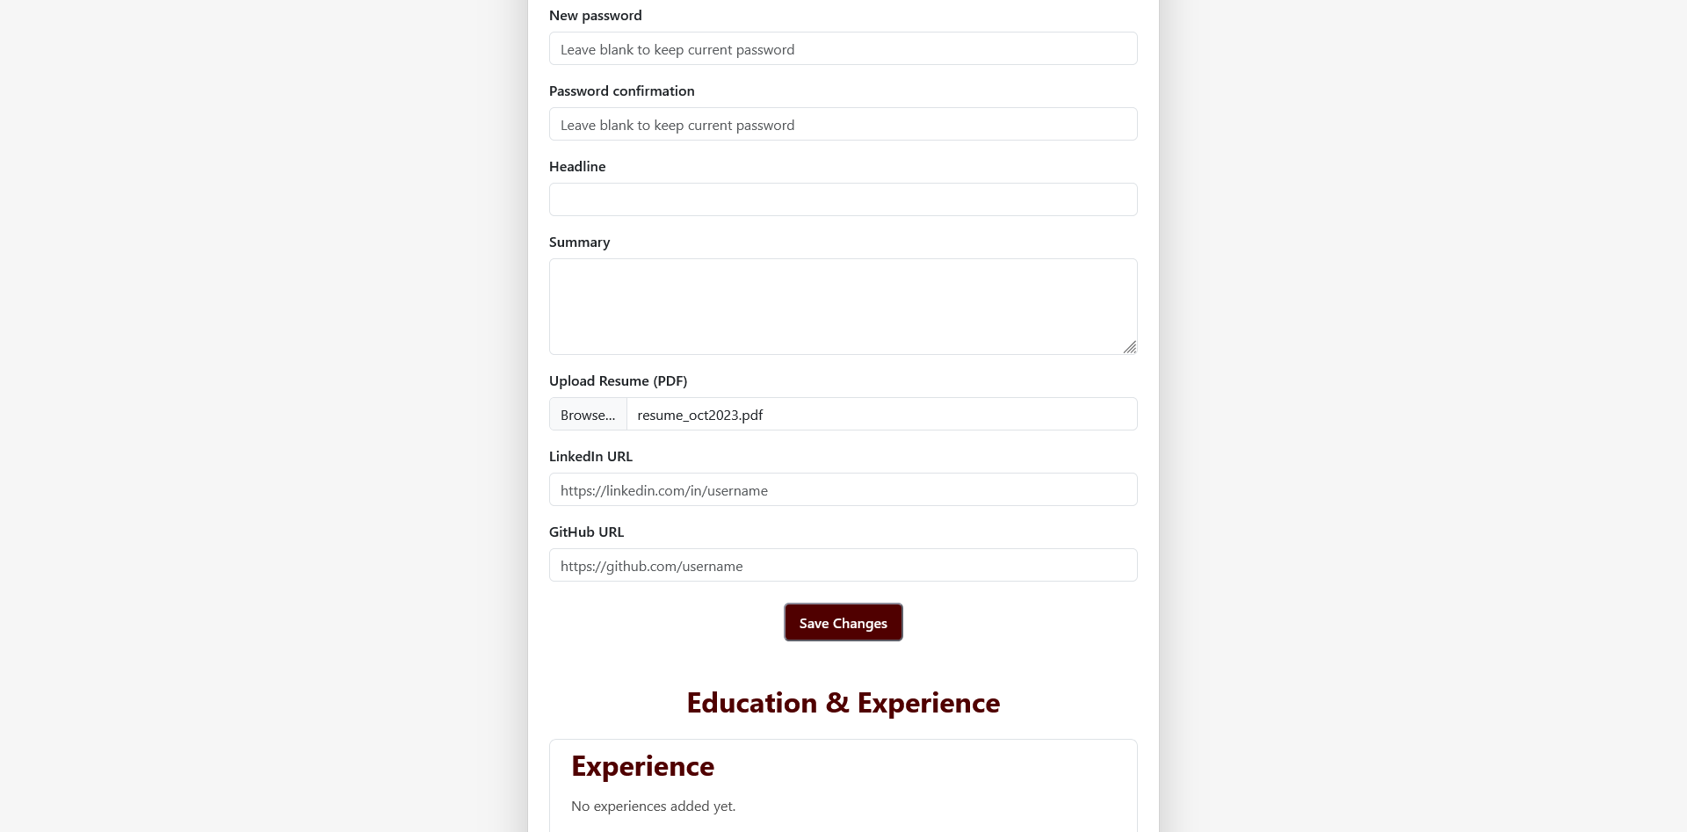
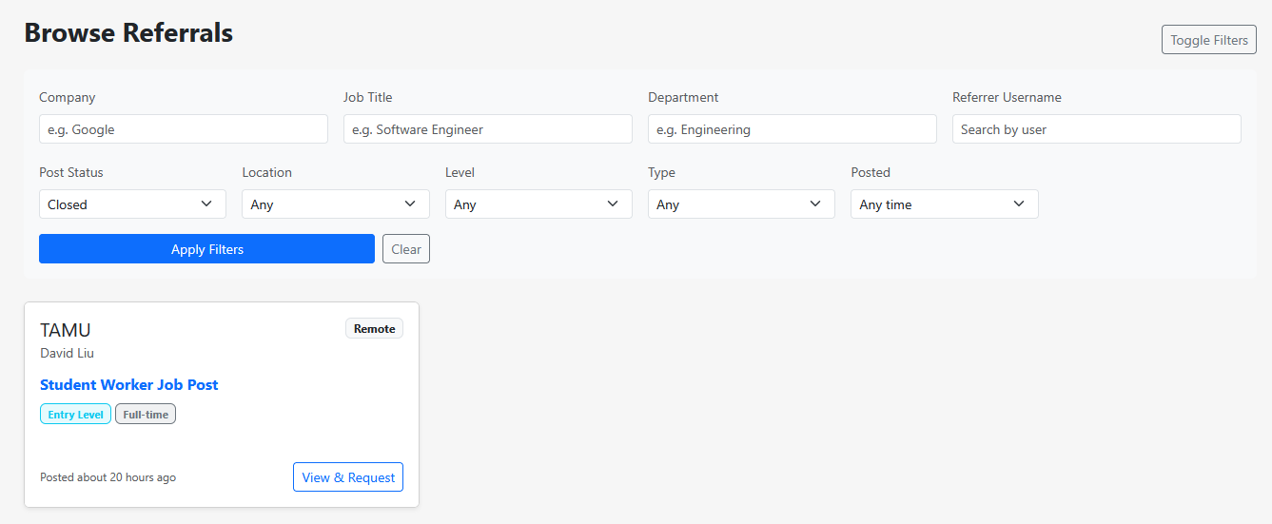
K. Pradhan
K.Pradhan
Edit Profile Page
Uploaded Resume
K.Pradhan decides to also edit his profile on the Edit Profile Page. He also uploads his resume on the application.
Later, K.Pradhan notices that the Student Worker Job Post created by D.Liu is closed on the dashboard page.
K.Pradhan
Profile Page

Slide 20

UI/UX Design - Design Principles Applied
Consistent Navigation: Fixed Navigation Bar, Active State Highlighting, Logout Button always visible for quick session termination
Progressive Disclosure: Status Badges, Collapsible Filters can be toggled to reduce visual clutter, Expandable Request Details shown only when clicking "See Full Submission"
Guided Workflows: Step-by-Step Verification, Question-Answer Forms, Domain Matching Helper showing expected email domain based on company name
Visual Feedback: Flash Messages, Loading States change during form submission, Inline Validation on form inputs (email format, password strength)
Mobile-First Design Responsive Grid, Touch-Friendly Buttons, Readable Typography

Slide 21

AI Tool Usage
ChatGPT:
Code Explanation & Debugging: To understand complex error messages and suggest fixes for RSpec and Cucumber tests.
Boilerplate Generation: For generating standard Rails controller actions and model specs.
Best Practice Consultation: For inquiring about the idiomatic way of doing stuff in ruby.

Slide 22
Challenges & Lessons Learned
Challenge 1: Email Verification Flow Complexity: Problem: Managing two separate verification flows (TAMU email and company email) with different token systems and mailer logic caused confusion during testing. Lesson: When building multi-step verification systems, isolate each flow with separate controllers, mailers, and routes to avoid coupling and confusion.
Challenge 2: JSONB Data Handling Across Environments: Problem: SQLite stores JSONB as text, while PostgreSQL has native JSONB support, causing inconsistent behavior between development and production. Lesson: When using JSONB fields, always normalize data in model callbacks to ensure cross-database compatibility and predictable behavior.
Challenge 3: Referral Request Status Workflow: Problem: Complex state transitions (pending → approved → closed post) with side effects (conversation creation) required careful transaction management to maintain data integrity. Lesson: When status changes trigger multiple database operations, always use transactions to maintain atomicity and prevent partial updates.

Slide 23




Future Plans & Opportunities
Enhanced Notifications & Messaging: Real-time email/in-app alerts with WebSocket chat, LinkedIn integration, and notification center
Advanced Analytics & Matching: AI resume parsing, referral success tracking, Elasticsearch, and analytics dashboard
Mobile & API Development: RESTful API for native iOS/Android apps with background job processing
Security & Compliance: Two-factor authentication, GDPR tools, audit logging, and token expiration

Slide 24

Thank You

